Slide 1
Constitutional change in an international context but from a Scottish perspective Lynda Towers Director of Public Law

Slide 2
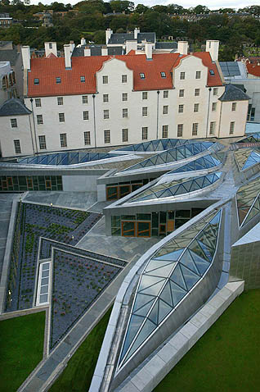
Scottish History…
Scots law and culture
Union of the Crowns 1603
Act of Union 1707
Jacobite Rebellions 1715 and 1745
20th Century Rise of nationalism
First Devolution Referendum 1979
Second Devolution Referendum 1997
Scottish Independence Referendum 2014

Slide 3
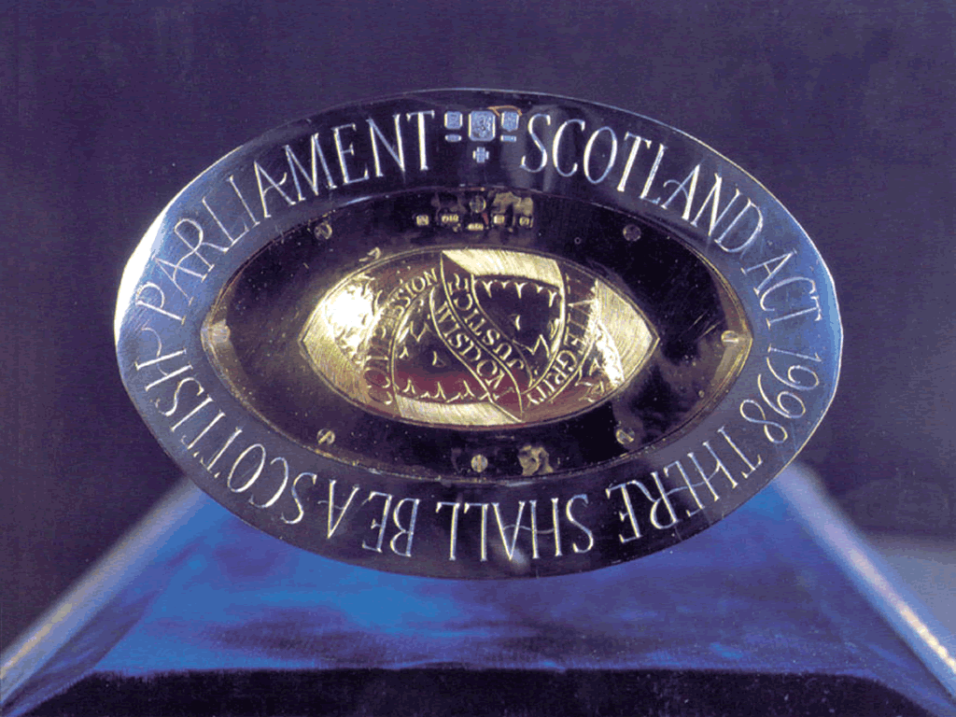
“There shall be a Scottish Parliament”

Slide 4
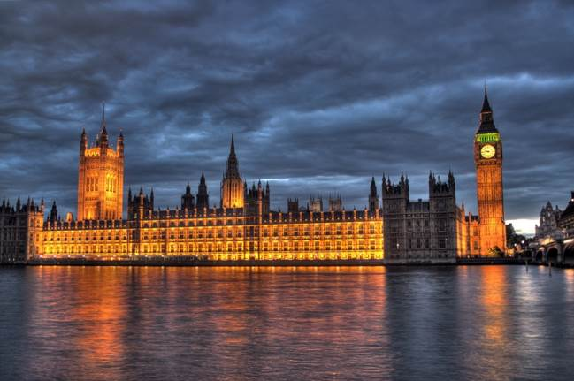
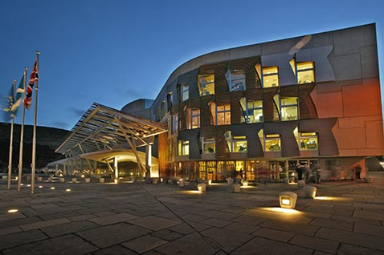
Devolution is a process and not an event….

Slide 5
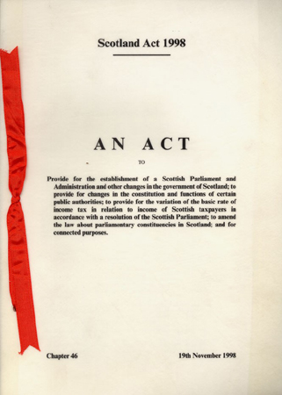
The Scotland Act 1998
Functions which are not reserved are devolved
Initially different in Wales
Very few challenges to legislation
Main challenges under European Convention on Human Rights
Westminster still the sovereign parliament
Powers are transferring- sort of…

Slide 6
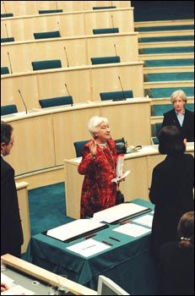
Modern History
12th May 1999- Winnie Ewing MSP
“The Scottish Parliament adjourned on the 25th day of March 1707, is reconvened.”
Scotland Act 1998 s 28
“(1)Subject to section 29, the Parliament may make laws, to be known as Acts of the Scottish Parliament.
………
(7)This section does not affect the power of the Parliament of the United Kingdom to make laws for Scotland.”

Slide 7
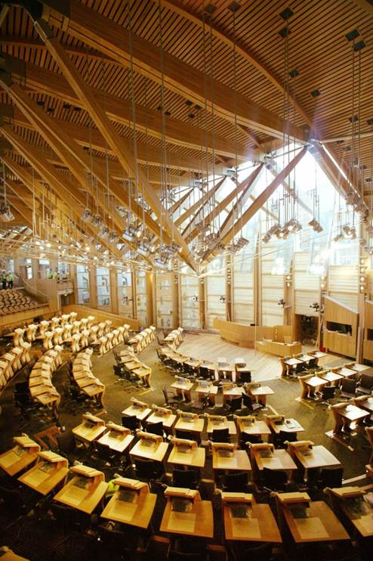
The early years….
Donald Dewar’s death in 2000
Henry McLeish resignation in 2001
The building…
Falling beams…
Taxi expenses scandal
Coalition Government
Legislation “factory”
The first ASP
Few legal challenges –ECHR
Close relations with UK administrators
Most of Scotland’s Councils the same political colour but some nationalist inroads

Slide 8
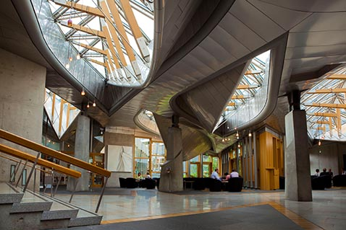
Early years (contd)
We saw ourselves as a nation and as forward thinking/socially radical
Great expectations of the Parliament and our MSPs
Who were we? - Tartan Week, EU role, Outreach in Embassies
Scandinavian social rights approach
Open Parliament
Committees
Petitions
Events/Festival of Politics
Education centre/outreach
Tours

Slide 9
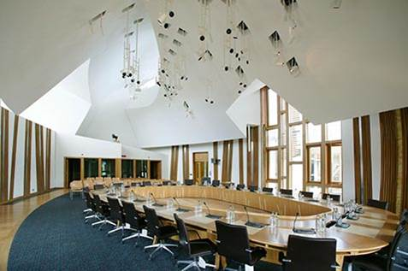
Radical Scotland?
Smoking ban
Votes for 16/17 year olds
Free prescription charges
Free personal care
Minimum pricing of alcohol
Independence Ref
Community Engagement
Land Reform
Police Scotland/Scottish Fire Service
Circus animals/fur farms
Approach to knife/gang crime looking abroad for inspiration
Too much focus on Indyref 2 and not enough on the basics?
Social security
Tax

Slide 10
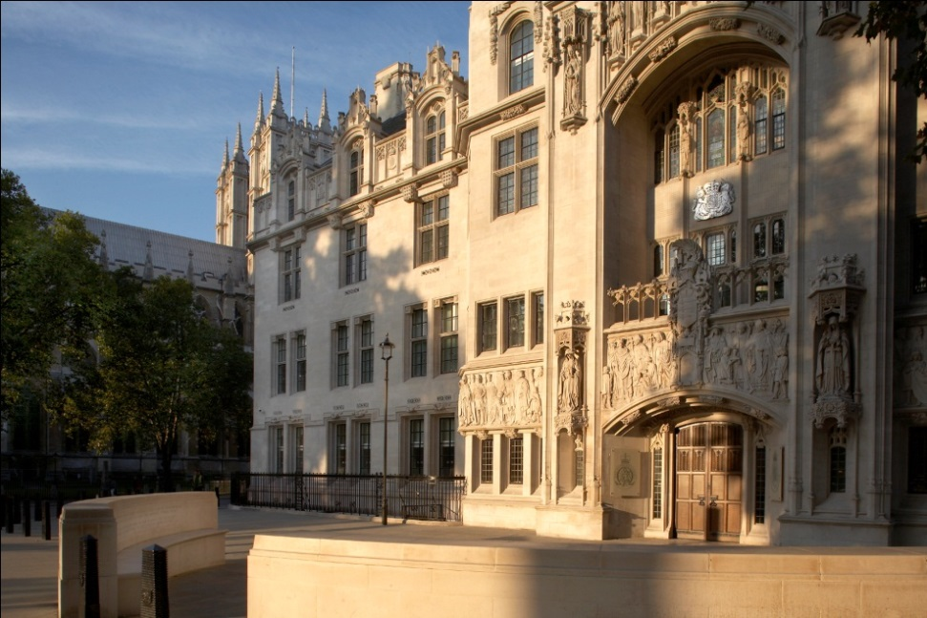
Cases with a kilt….
Donoghue v Stevenson- snails and ginger beer
Axa Insurance v Lord Advocate – all the devolved administrations
Scotch Whisky Assoc v Lord Advocate – minimum pricing
Christian Institute v Lord Advocate- use of data
Miller v S of S for Exiting the EU – Sewel Convention
Wightman v S of S for Exiting the EU – Art 50
UK Withdrawal from the European Union (Legal Continuity) (Scotland) Bill - 2018

Slide 11

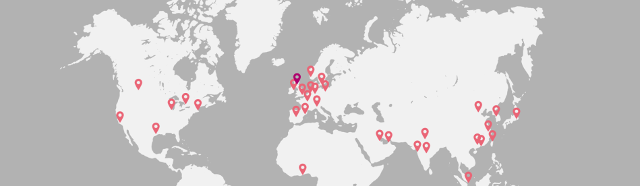
Where to now?
Scottish Parliament changes
More civic voices
Brexit?
Union secure?
ECHR secure?
UK regulation - agriculture
Indy Ref 2?
Local services
Currency
EFTA?
Artic Strategy
International strategy –Scottish Development International/ other offices
GlobalScots - diaspora

Slide 12
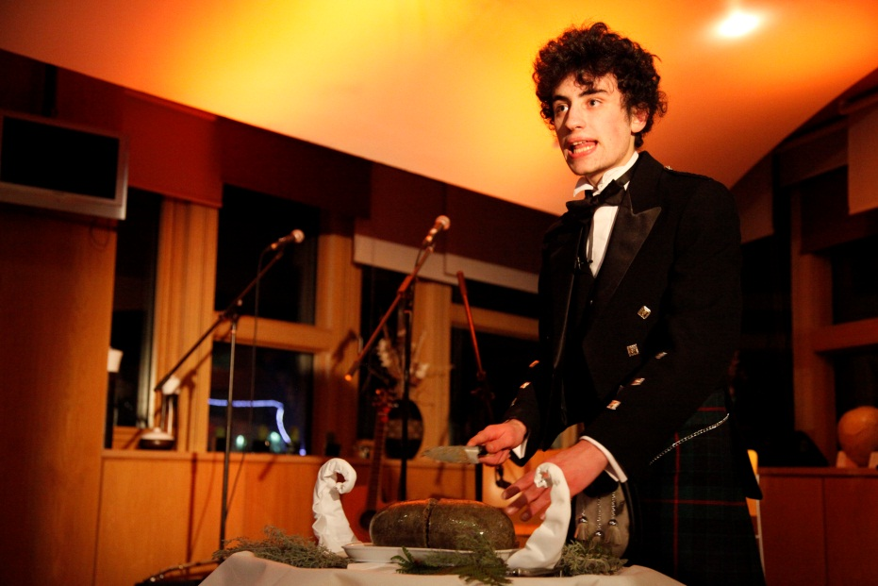
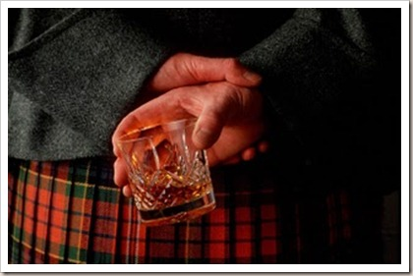
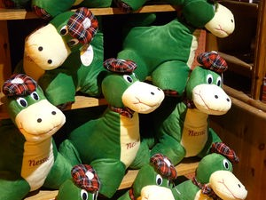

Slide 13
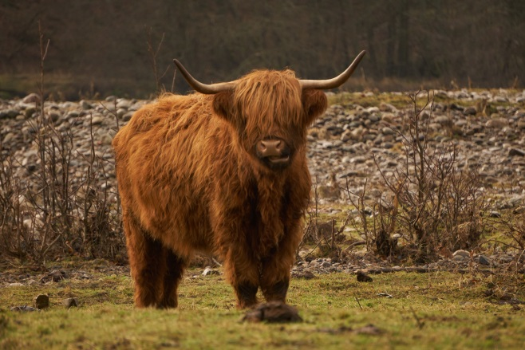
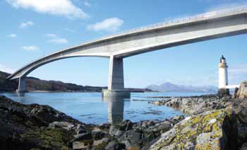
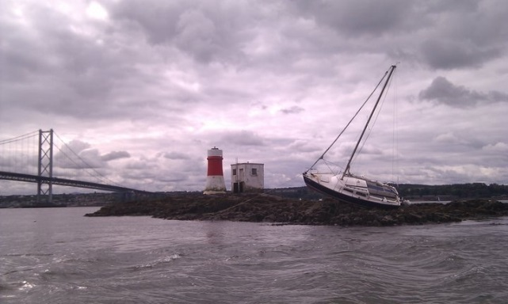
“Probably the best small country in the world….”
Challenges for the UK relationships
Oil and Gas
Talent/Skills
Immigration
EU membership
Fishing/Agriculture
Tourism
Climate Change
Maritime strengths

Slide 14
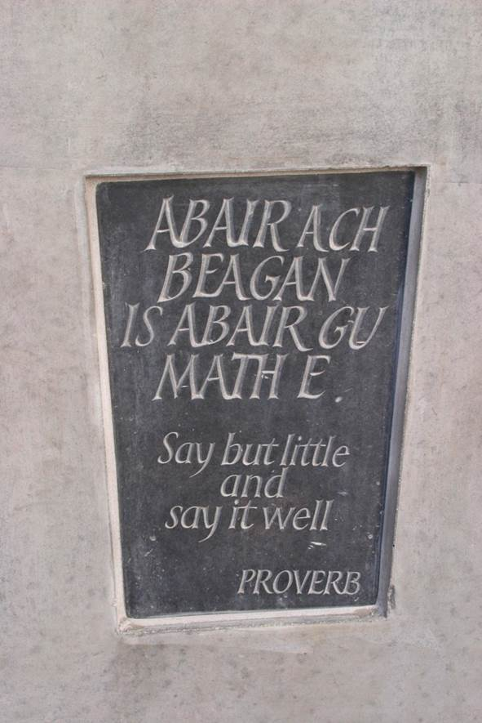

Slide 15
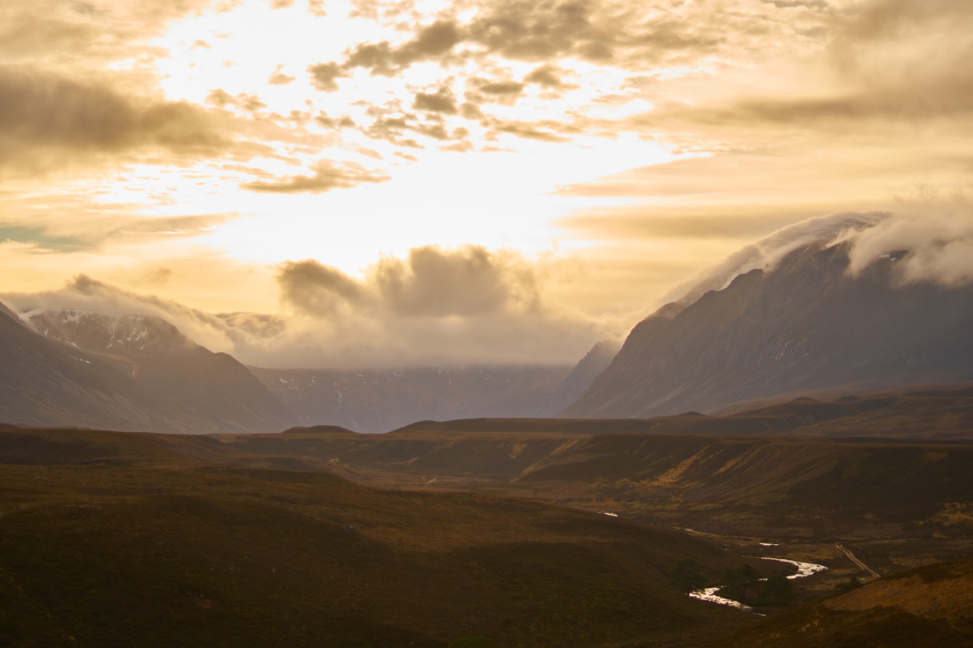

Slide 16
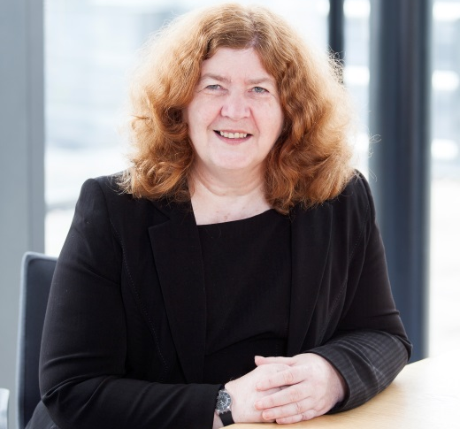
Lynda Towers Director of Public Law

