Slide 1

Digital devolution or actual revolution? The relationship between digital services and democracy
Dr Catherine Howe – June 2019

Slide 2



A short history of me
Democratic Society
I have worked in technology for nearly 20 years (eek) – ranging from start ups, higher education, a FTSE100250 business and current adventure is in the third sector
My research focus is on using the social web to do democratic things exploring the concept of digital civic space
I am interested in digital leadership and the skills we need to work effectively in the network society
Feel free to tweet any questions to @curiousc

Slide 3
3 different tribes and the spaces that sit between:
Digital
transformation
Networked
Social movements
Democratic Innovation
How are we navigating the end of the industrial society?
How do we avoid leaving people behind?

Slide 4

The hypothesis
Design and digital in government has become detached from developing democratic models - missing an opportunity for mutual reinforcement and better outcomes.

Slide 5
The dilemma
If your digital people aren’t driving a revolution then they are the wrong people
If your digital people are driving a revolution then what does it mean for your democracy?

Slide 6

Lets talk about those digital people

Slide 7
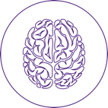

They have a digital* mindset
Example:
Collaborative and multidisciplinary
Open: confident about sharing work
in progress and thinking in public
Example:
Self-managing and engaged
Example:
Example:
Example:
Confident in using
iterative and experimental approaches
Clear on your own
relevance and contribution
Example:
Able to take data-driven decisions
Able to work with networked as well as hierarchical power
Example:
7
Notes:
Learning points
- This model is a foundation for the whole session so important that each element is understood
- There are separate materials describing the model in more detail

Slide 8
They are made up of 8 (warring) tribes each with their own definitions of digital
Notes:
Learning points:
- 8 tribes model is something we use with client as well as internally
- its an ongoing research project
- Each tribe represents a new wave of technology
- They are called tribes as they dictate behaviours as well as skills and knowledge
Learning points on each of the tribes are embedded in the following slides

Slide 9
With some things in common:
User centred design approaches; they want evidence of user need before they will build something
Preference for iterative change; albeit at different rates of iteration
Emphasis on expert led decision making; designed around self-managing teams with a high degree of autonomy
They are highly sought after; these are people with choices
They are (supremely) confident in their relevance

Slide 10
Their concerns reflect our changing relationship with technology
A focus on responsible and intentional technology
Awareness of the gap between old and new ways of doing things
A growing ambition for impact:
Process
Service
Organizational
System design
Digital is no longer about technology

Slide 11
Anyone who is thinking about democracy has a different set of concerns

Slide 12
Our traditional democracy is in crisis
Trust in our traditional parties has collapsed. Alongside a changing democratic voice its bringing a rise in participatory democracy and a renewed understanding of the important of deliberative methods
Early enthusiasm for internet led democracy has led us to understand that the answer is not surprisingly more complicated than we thought

Slide 13

Representative democracy was never supposed to work without the 4th estate – we didn’t design for a population of news creators

Slide 14
But the challenge is bigger than fake news
Networked social movements are having an impact on complex issues
New Economic thinking is driving a more localist agenda
Trust in public institutions is crashing
After some great first dates Technology has not been a friend to democracy
Democracy has no built- in method for innovation - it traps power in the current structures

Slide 15
Complexity drives a need for deliberation
We have hollowed out our democracy and dangerously diminished our ability to deal with complexity just as the world is becoming exponentially more complex

Slide 16
How do we address our dilemma?
The same people who are driving digital change find themselves alienated and let down by our traditional democracy

Slide 17
By bringing their worlds together

Slide 18
Put your faith in humans
Users, citizens and staff are the same people – treat them with the respect they deserve
Who is having the conversation with the public?
Where are the representatives in this process?
User
User centred design
User research
Citizen
Engagement
Consultation
Insight
Coproduction
Co design

Slide 19
Give power to the people with the knowledge
Within an organisation this is creating a more horizontal and distributed organisational design
Within a democratic body this is devolving more power to communities
Hierarchies
Are replaced with networks

Slide 20
Change the way you make decisions
Processes
One System
Many
many
Organisations
different
services
Made
up
of
Processes
Processes
Processes
Processes
Processes
Processes
Processes
Processes
Processes
Processes
Processes
Decision making needs to change to be both small and agile but also effectively systemic:
  Greater local control of processes and services
  Better mechanisms for dealing with independencies
  More transparent and able to learn
Create forums for deliberation

Slide 21
Think differently about change
Transformation – in any realm - has to mean power, agency and devolution of tools to people closer to the problem
It needs local control with system shaping and accountability
It needs people to think about how they are shaping the operating environment – you need to effect the context to effect real change
This only works if we also have people looking after the health of the system
Which came first? The technology chicken or the societal egg?
It has to be the egg

Slide 22

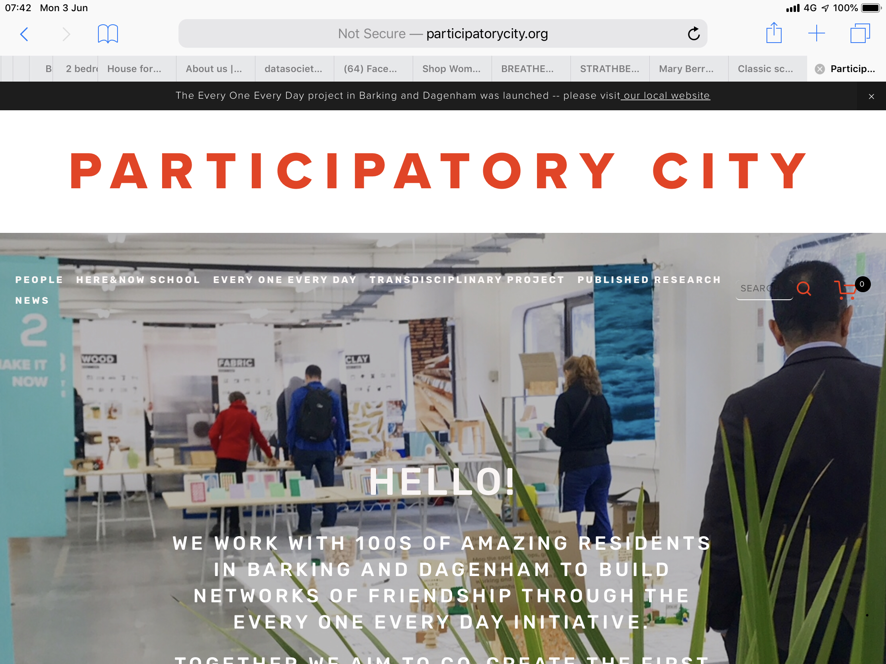

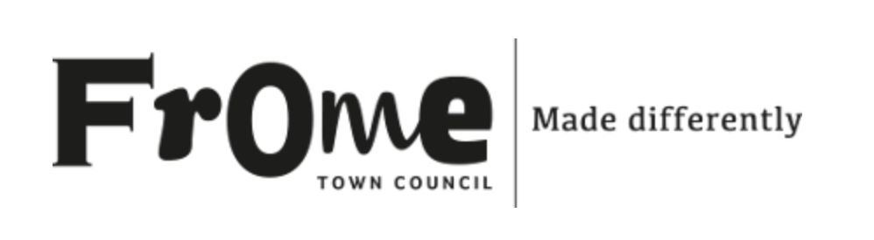
What does good look like?

Slide 23
The last word
Technology can drive change but we should be cautious about letting it – or its evangelists - shape change.
But unless we adapt our democracy, digital platforms will evolve beyond it.
We need devolution to avoid a revolution

Slide 24
Thank you
@curiousc
https://medium.com/@curiouscatherinehowe
https://www.linkedin.com/in/curiousc/

