Slide 1

How can local democratic innovation overcome the global democratic recession?
Dr Oliver Escobar
Senior Lecturer in Public Policy, University of Edinburgh
Co-Director, What Works Scotland
IIMC Symposium, Stratford-upon-Avon 2019
@OliverEscobar
@WWScot

Slide 2

the big picture: global democratic recession?

Slide 3
Democratic Recession
Last 10 years > reduction in the number of democratic systems > established democracies are under increasing pressure due to social, political, environmental and economic factors (Wike & Fetterolf, 2018)
The Democracy Index 2016 >>
  global average score fell with 72 countries dropping in the ranking compared to 2015, and just 38 moving up
  number of ‘full democracies’ dropped from 20 to 19 (USA now classed as ‘flawed’)
  around half the world's population (49.3%) live in a democracy of some kind. But only 4.5% of people live in a “full democracy” - half as many as in 2015
Democratic principles enjoy broad support, but current practices and institutions provoke cynicism > people love the idea of democracy, but despair at how it is practiced
Global Attitudes Survey shows increased indifference, frustration and authoritarian attitudes particularly in the youngest populations of democratic systems around the world (Foa & Mounk, 2016)

Slide 4
  What does ‘participatory democracy’ mean?

Slide 5
In participatory democracy…
“…citizens govern themselves directly, not necessarily at every level and in every instance, but frequently enough and in particular when basic policies are being decided and when significant power is being deployed.
This is carried out through institutions designed to facilitate ongoing civic participation in agenda-setting, deliberation, legislation, and policy implementation…”
Benjamin R. Barber, Strong democracy, 1984

Slide 6
Why public participation? (Involve 2005)
Addressing complex problems drawing on untapped knowledge, experience and perspectives
Making better policies and legislation and ensuring effective implementation
Improving public service design and delivery
Building legitimacy and trust in public institutions
Developing citizens’ skills, confidence and ambition
Enabling active citizens and communities
+ Need to improve accountability, legitimacy, expediency and effectiveness in local policy and decision making

Slide 7
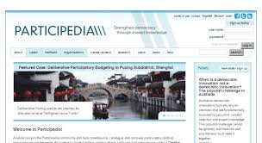

https://participedia.xyz
  International trends in participation

Slide 8
Citizenship today: 2 stories
Story of decline
Story of progress
Declining…
  Voter turnout in elections
  Trust in & legitimacy of traditional institutions of public life (e.g. government, media, parties, unions, community associations, etc)
  Social capital: community ‘ethos’ & networks
(Dalton 2005; Putnam 2001)
What’s happening is that citizens are becoming:
  better educated, more knowledgeable and critical;
  less deferential to traditional authority and elite-driven / hierarchical forms of governance;
  dismissive of conventional channels and engaged in alternative forms of political expression;
The myth of public apathy
(Norris 2002; Castells 2012; Dalton 2017; Eliasoph 1998)

Slide 9
Debunking the myth of public apathy:
Civic participation in Scotland
Record-breaking participation in the independence referendum (84.6%)
A growing, vibrant civil society / third sector: social enterprises, community development trusts, housing associations, transition towns, charities, etc
Civic participation on the rise:
  55% in 2009
  61% in 2013
  69% in 2015
  (Scottish Social Attitudes Survey 2013 and 2015)

Slide 10
But is all participation good?
Paradox of growing participation and growing inequalities (Walker, McQuarrie & Lee 2015)
  proliferation of traditional consultation and lack of empowered participation
Inequalities in health, income, wealth, education… stemming from inequalities of power and influence
The participation gap (Dalton 2017) – growing gap between the ‘politically rich’ and the ‘politically poor’
unless corrective measures are taken “participation of all varieties will be skewed in favour of those with higher socioeconomic status and formal education”
(Ryfe & Stalsburg 2012)

Slide 11
Please stand up if you have participated in a public forum/meeting to discuss policy issues in the last year

Slide 12
Stay standing if at that forum there was a reasonable…
…gender balance
…mix of personal and professional backgrounds
…range of perspectives and opinions
… age range (i.e. 3 generations)
… income range
…sense that most participants felt included and influential
…sense that most participants enjoyed it
… sense that their participation would have a clear impact

Slide 13
Key challenges in public participation processes
Inclusion and diversity
Quality of dialogue and deliberation
Impact

Slide 14
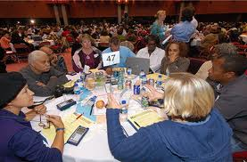
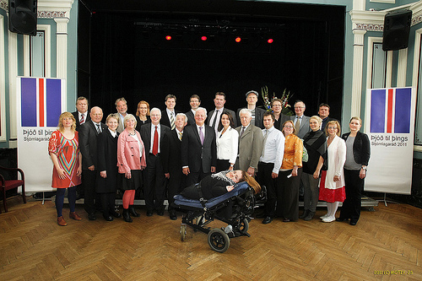
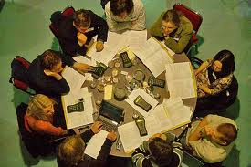
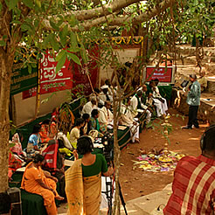
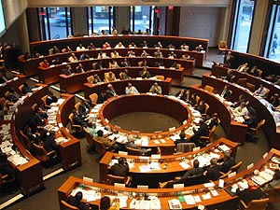
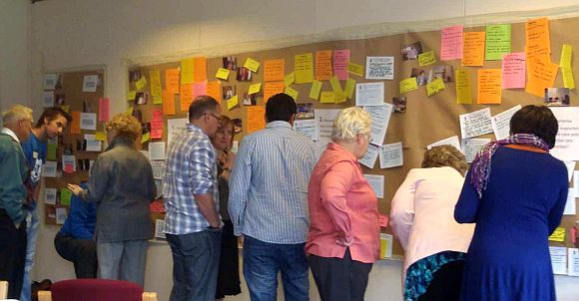
The growing field of Democratic Innovation:
Building institutions for
participatory democracy
Notes:
14

Slide 15

Democratic innovations are processes or institutions developed to reimagine and deepen the role of citizens in governance processes by increasing opportunities for participation, deliberation and influence

Slide 16
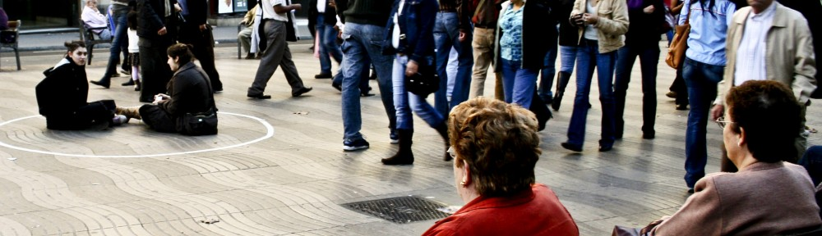
  What Works in public participation?

Slide 17
3 components of ‘what works’ in public participation
Multi-channel
Inclusive & deliberative
Empowered & consequential

Slide 18
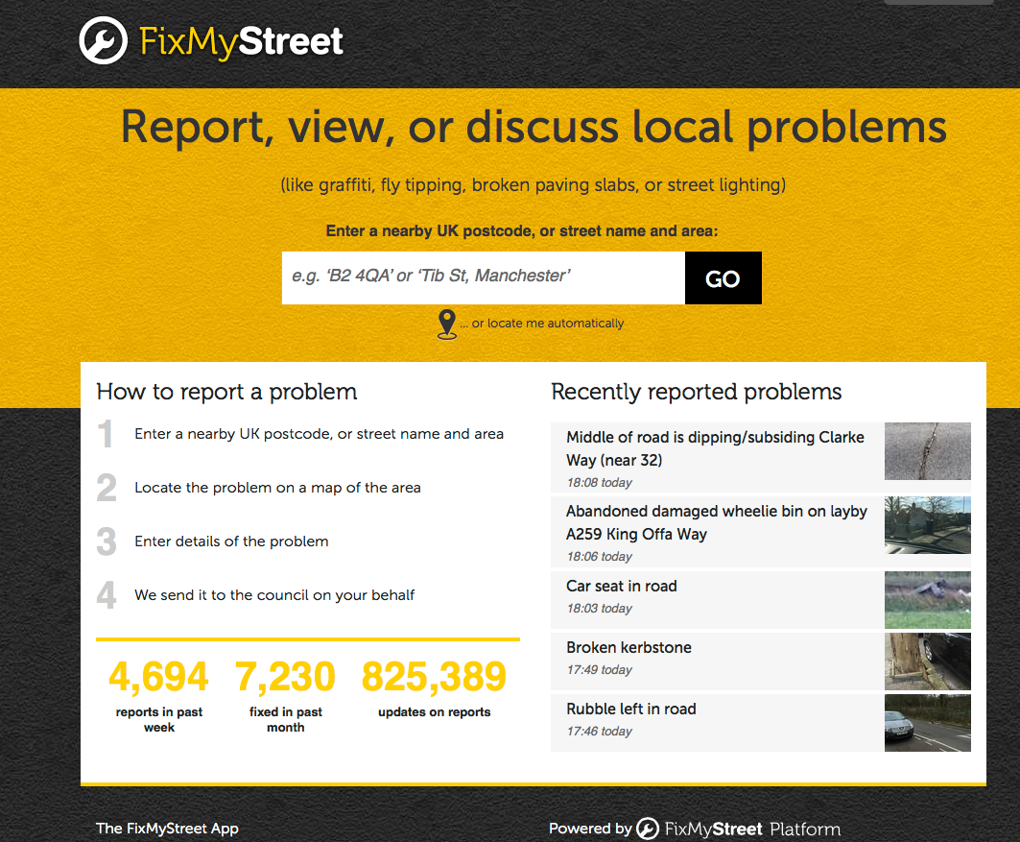
Multi-channel
Developing a variety of channels for participation:
  online, face to face, combined
  light-touch vs. intensive
  ‘crowdsourcing’: tapping ‘the wisdom of the crowds’ (Surowiecki 2005)
Examples:
  Fix My Street www.fixmystreet.com
  MapLocal https://maplocal.org.uk
  U-Report Uganda www.ureport.ug

Slide 19
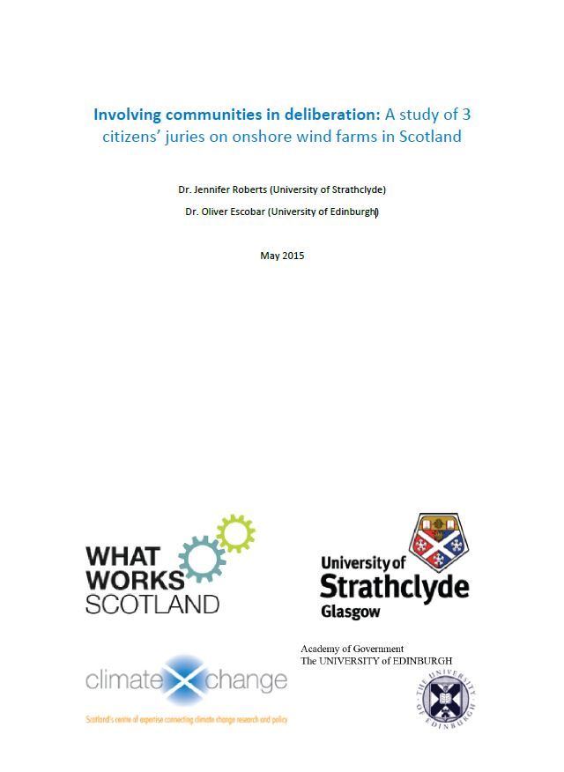
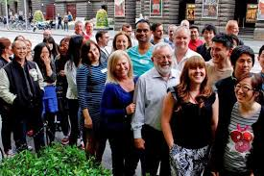
Inclusive AND deliberative
Inclusion and diversity are crucial for legitimate and effective participation
  demographics AND perspectives
  lowering barriers to participation
Deliberative engagement is about:
  assessing evidence
  hearing & scrutinising different views
  then, making informed decisions
Examples –’Mini-publics’:
  Melbourne Citizens’ Panel on Local Finances
  Citizens’ Juries in Scotland
  Madrid Decides –permanent citizen body alongside legislature?

Slide 20
‘Mini-publics’
A ‘mini-public’ is a deliberative forum where a group of citizens (12-1,000) is:
  selected via ‘civic lottery’, and compensated, to reflect the diversity of the public affected by the issue,
  given a task (e.g. setting priorities, reviewing services, producing plans, judging competing evidence)
  and given time and support to develop considered opinions and judgements.
  Many types: citizens’ juries, consensus conferences, planning cells, citizens’ assemblies, etc
Equalities emphasis
  Measures in place to lower barriers to participation and minimise self-selection bias (E.g. stipend, random selection, support)
It generates decisions or recommendations that authorities must respond to, and which inform broader public engagement / public deliberation

Slide 21
The City of Melbourne
People’s Panel (2014)
Composition: 43 members randomly selected from the population (50/50 split between residents and business owners)
Task: scrutinise 10-year financial plan worth $5 Billion (in light of $1.2 Billion gap)
Principles provided by the Municipality: to be specific, realistic and forward thinking and for their ideas to be sustainable, achievable, relevant to the challenges and to add value to the city
Broader community and stakeholder engagement process feeding into the Panel
Result: 11 recommendations embedded the Council’s 10-year financial plan, including spending and revenue priorities

Slide 22
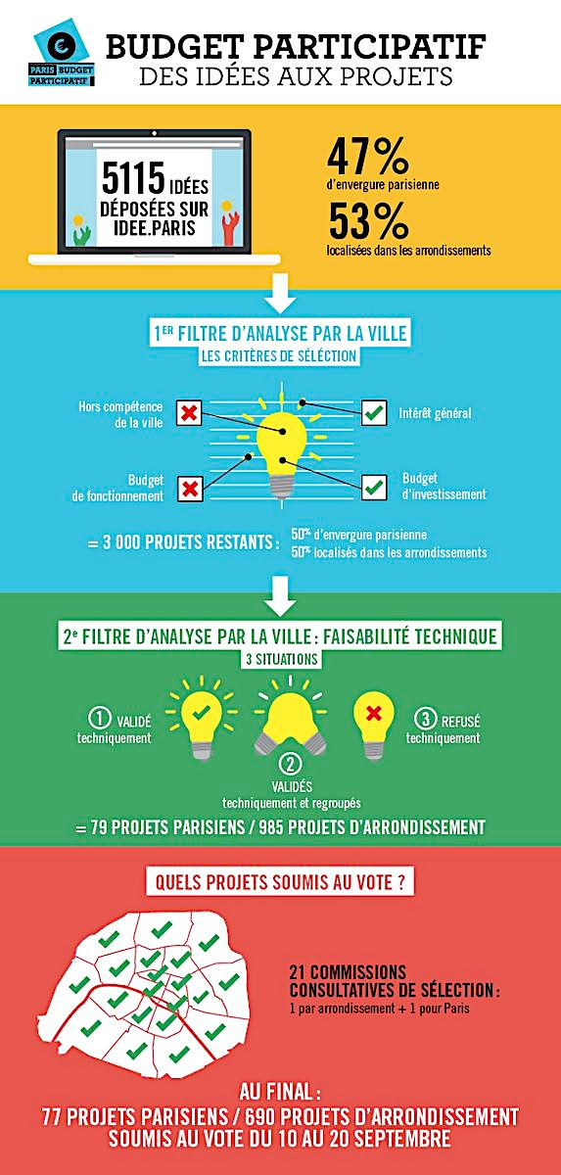

Empowered and consequential
Participation thrives when important issues and resources are at a stake, and citizens feel their contribution can actually make a difference
Example:
  Participatory Budgeting, from Porto Alegre (Brazil) to 2,700 localities around the world
  Better Reykjavik
Notes:
Paris example

Slide 23
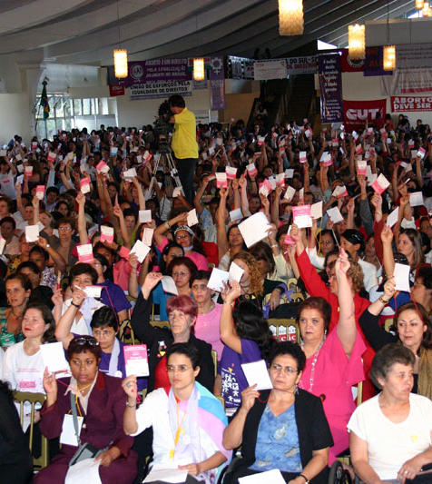
Participatory Budgeting:
Outcomes in Porto Alegre and Brazil
Baiocchi 2001, 2005; Sintomer et al. 2012; Wampler and Touchton 2014
Increased new housing for poor families > 1986-1988=1,714 families; 1992-1995=28,862 families
Increased number of schools and nurseries > 86 schools in 2001 (vs. 29 in 1988)
Improved infrastructure
  20 Km of new pavement yearly in poorest areas
  98% residents have running water (vs. 75% in 1988)
Reduced spending in administrative costs and improved relationships between residents and local government officials
Increased citizen participation
  Up to 50,000 participants + good representation of disadvantaged groups
Beyond Porto Alegre > over 200 localities in Brazil, measurable reduction on indicators of health inequalities over 25 years (e.g. infant mortality)

Slide 24

  what does this mean for your community of practice?

Slide 25
Key challenges in the development of participatory culture and capacity in local government
Reshaping mindsets and ways of working
  Commitment to democratic innovation from public servants, elected representatives, civil society groups and citizens
  Facilitative leadership
Inequalities of power and influence within communities of place, practice and interest:
  lowering barriers to participation and creating a level-playing field
  democratic innovations can clash with established relationships and dynamics in policy networks
Investment in developing
  capacity and skills: facilitation, process design, mediation, negotiation, brokering, etc
  infrastructure e.g. spaces, platforms
Long-term commitment, ongoing learning and adaptation: Understanding the synergies and tensions between representative and participatory democracy

Slide 26
21st century public servant
Traditional leader | Facilitative leader
Hierarchies | Networks
Certainty (knows everything) | Openness (constant learning)
Leads others | Helps others to lead themselves
Good at talking | Good at listening
Knows the direction | Helps others to work out the direction
Commanding and controlling | Facilitating and mediating
Builds alliances to win policy battles | Builds alliances to find workable policy agreements and solutions

Slide 27
Concluding: towards participatory democracy in local governance
Legal and administrative professionals have a crucial role in the development a more participatory democracy to improve local governance
Public servants at all levels can help to make space for democratic innovation by creating:
  enabling conditions,
  legislation and regulation,
  governance structures,
  and support for capacity-building.

Slide 28
  Everywhere there are waves of criticism and doubt as to whether democracy can meet pressing problems … Wherever it has fallen, democracy had not become part of the bone and blood of the people in daily conduct of its life. Democratic forms were limited to Parliament, elections and combats between parties.
  What is happening proves conclusively … that unless democratic habits of thought and action are part of the fiber of a people, political democracy is insecure. It can not stand in isolation. It must be buttressed by the presence of democratic methods in all social relationships.
  John Dewey
  The Public and its problems (1937: 467)

Slide 29
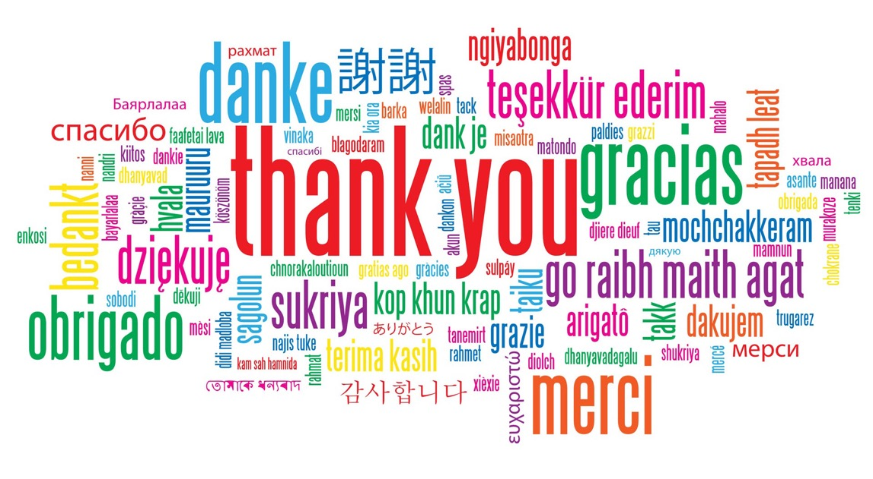

http://whatworksscotland.ac.uk/events/empowering-people-and-places-what-works/
@OliverEscobar
@WWScot

Slide 30
What is exciting AND/OR worrying about your role in democratic innovation?

