Slide 1

Lost in control - Refocus on purpose
Dr. Marius Buiting,
Stratford upon Avon 2019

Slide 2




















Post second world war period

Slide 3









Seventies & Eighties
huge amount of public resources
more regulations
based on transparancy
augmented with accountability
Notes:
Huge improvements, but at huge amounts of costs…which resulted in more regulations, transparancy and accountability

Slide 4

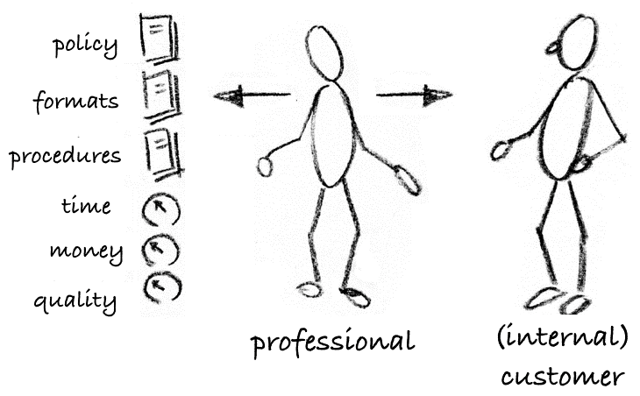

Slide 5
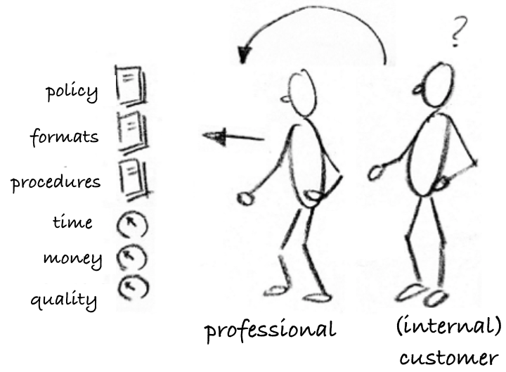

Slide 6

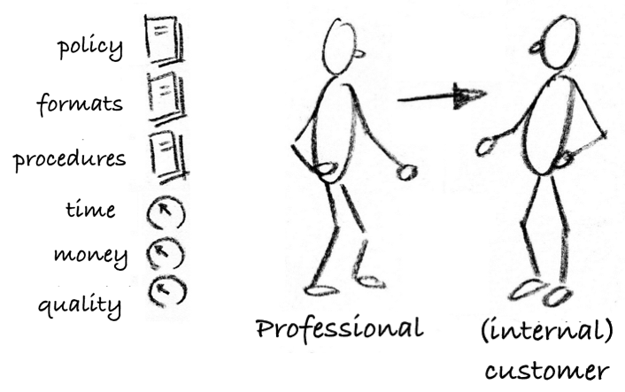

Slide 7


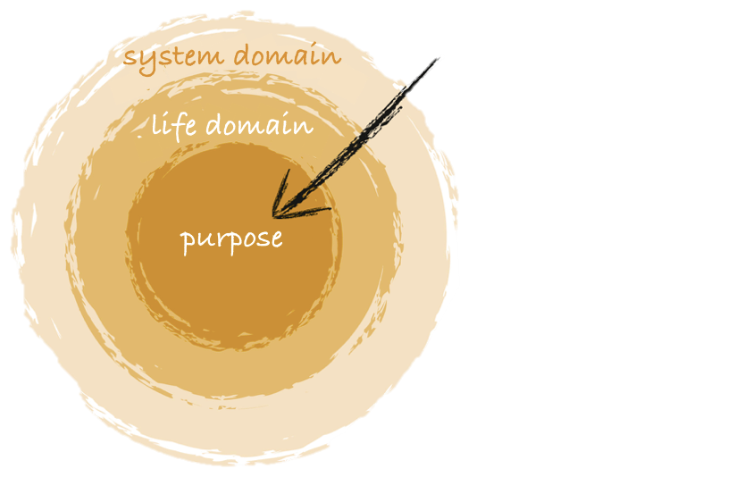
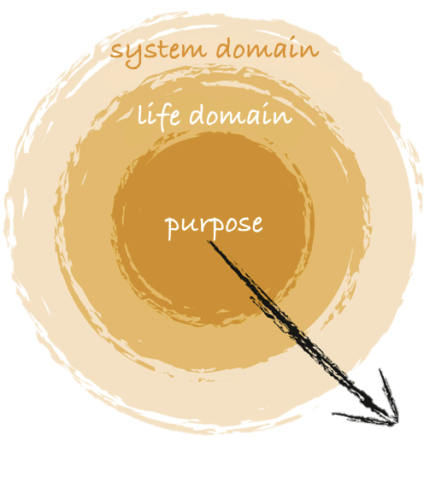
Late nineteen & early twentieth century

Slide 8














‘Changing individuals’
Completely dependant on healthcare
Emphasis on being a ‘patient’
‘Personalized health’
Emphasis on ‘disease’, dependancy
Emphasis on
a ‘good’ life
Locally & Nearby
Emphasis on
‘citizenship’
Fully empowered & participatory
Disruptieve innovations
‘Empowerment’ & ‘Self-management’
Mobile & Flexible

Slide 9

Source: SORENSEN, E., TORGING, J., 2013. Enhancing Social Innovation by Rethinking Collaboration. Leadership and Public Governance. In: Conference Social Frontier. London. 15 novembre 2013.

Slide 10

Shifting paradigms of Governance in Society
Board & Management
Area, Environment, Setting
‘Citizenship’
‘Wicked Problem’
Patient & Client Participation
Professional/Employee Participation
Formal and Hierarchical Structure
Energy+ driven

Slide 11

Shifting paradigms of Governance in Society
Ego
Eco

Slide 12
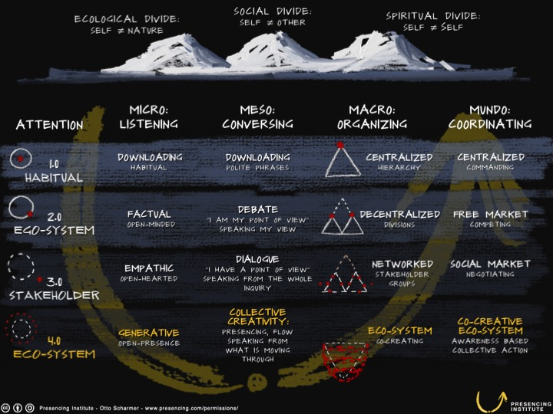

Slide 13
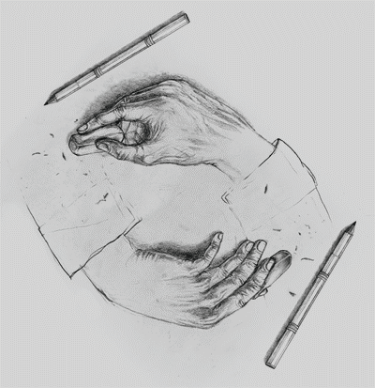
Less and More – Continuous Loading and Erasing
Notes:
Loading and erasing

Slide 14
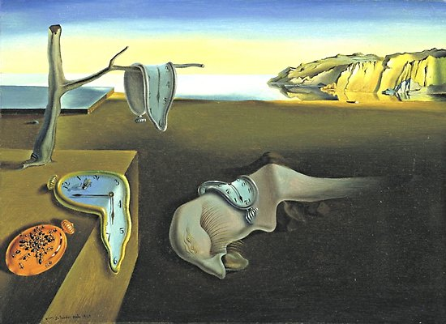


Less Chronos, more eye for Kairos

Slide 15

Less ‘Time-money-perspective’

Slide 16

More ‘Value-driven-perspective’

Slide 17


Less compulsion, more invitation

Slide 18
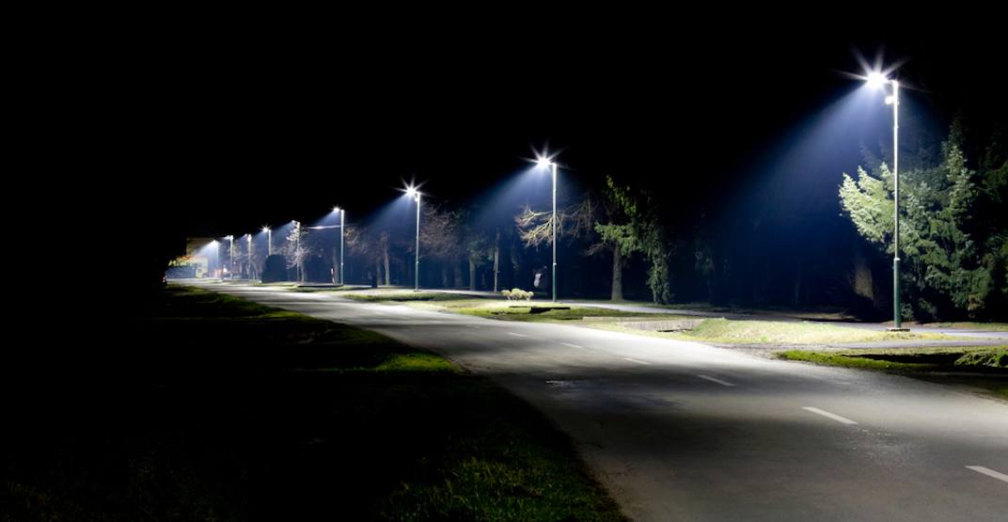

Less ‘streetlights’, more ‘campfires’

Slide 19
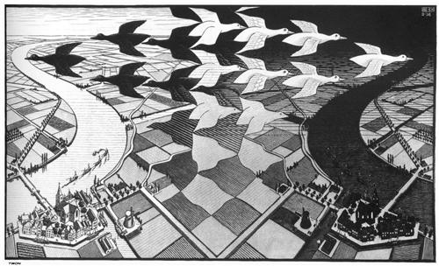


Less standardization, more Variation

Slide 20
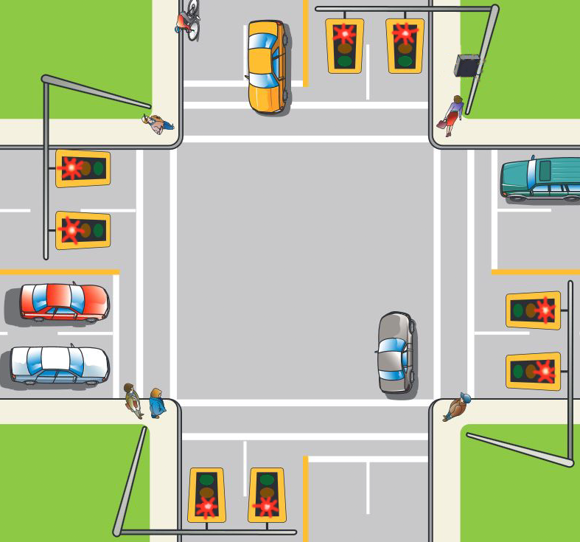
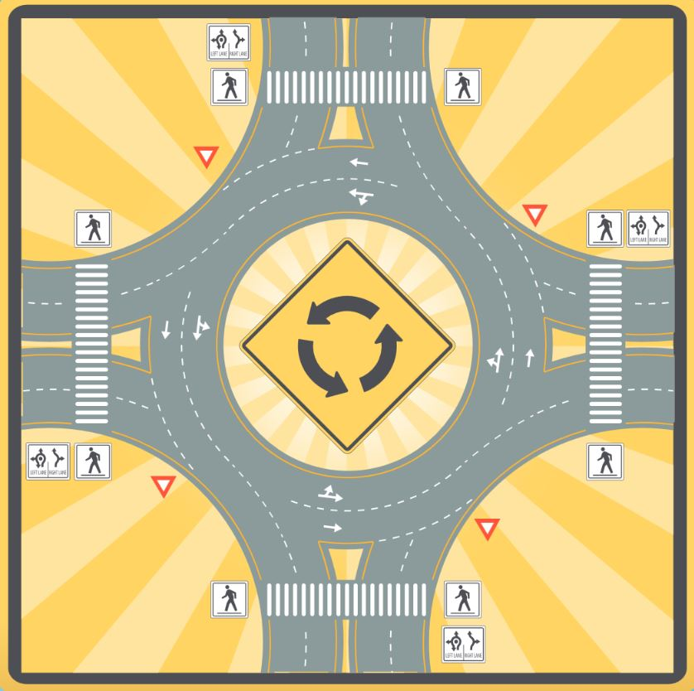
Less ‘Traffic light’ interventions, more ‘Roundabout’ interventions

Slide 21
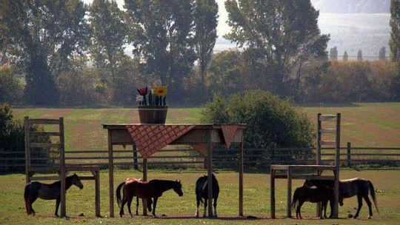
Notes:
This farmowner was denied a council permit to build a horse shelter. Fortunatelly you don’t need a permit to build a table and chairs!

